Slide 1






优质教学资源合集
优翼与一线教师联合编写，为各位老师提供优质的原创资源，内含教学课件、教案、配套习题课件、原创模拟卷、课文朗读音视频等资料。
实时更新！
扫码关注！
原创

Slide 2


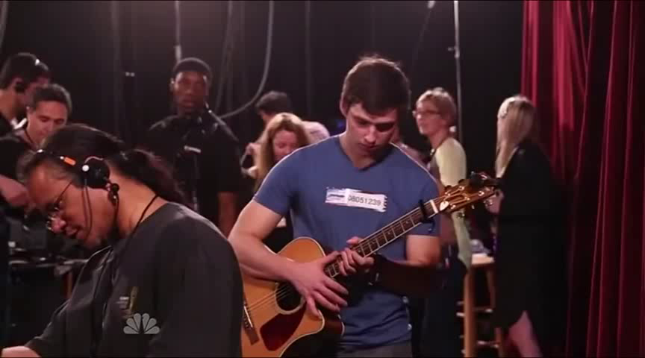
Lead in
Let’s enjoy a video !

Slide 3
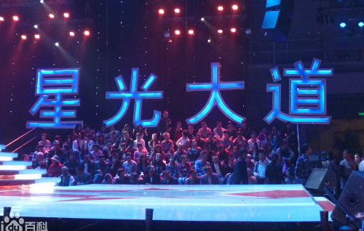


Free Talk
What kind of show do you think is it?
Have you ever watched the similar shows?
What do you think of the show?
How do you like the performer?

Slide 4
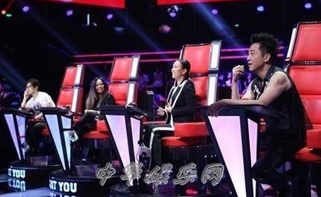
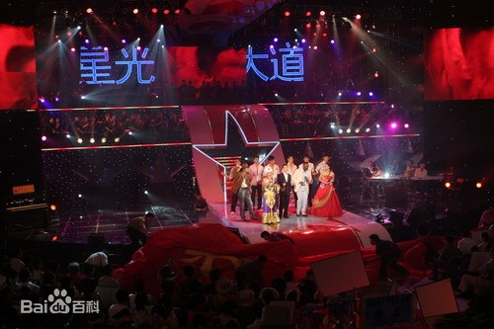
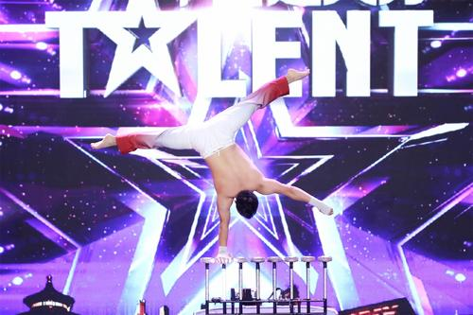
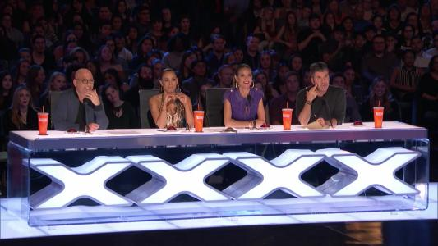
talent show
A talent show is a show where ordinary people perform an act on stage, usually in order to try to win a prize for the best performance.

Slide 5
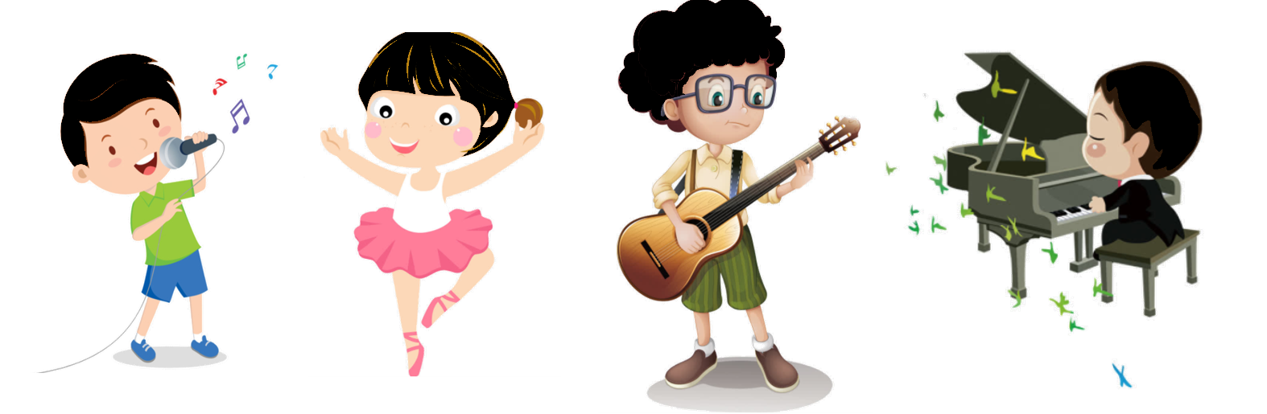
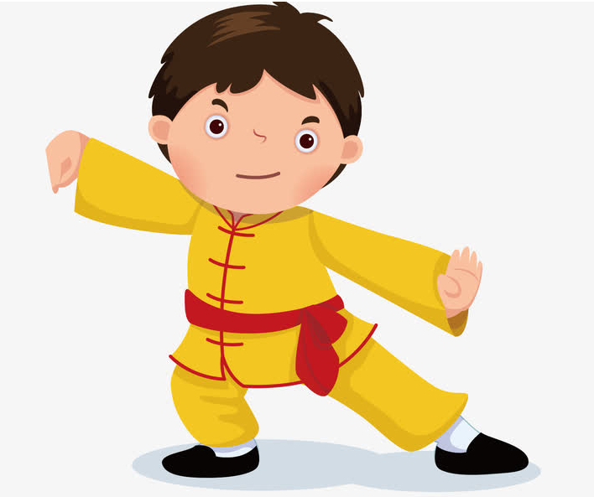
Do you have any talents?
Have you ever entered for any talent shows?

Slide 6
Pre-listening
Write these words and phrases next to their opposites in the chart.
1a
adj. 有创造力的；创造性的
funniest most creative quietest best
most boring | most creative
loudest
worst
most serious
quietest
best
funniest

Slide 7
1b
Tell your partner about people you know. Use the words in 1a.
most boring most creative loudest quietest
worst best most serious funniest
My cousin Li Jing is the funniest person I know.

Slide 8
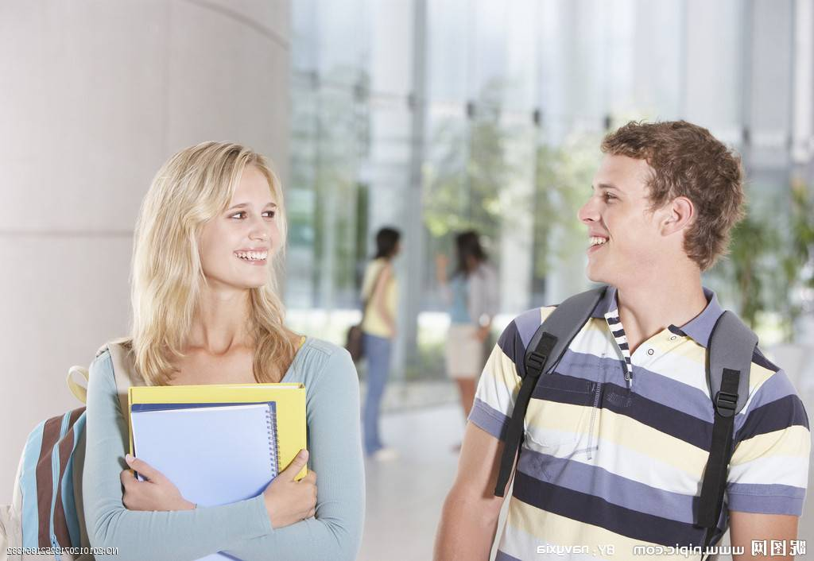
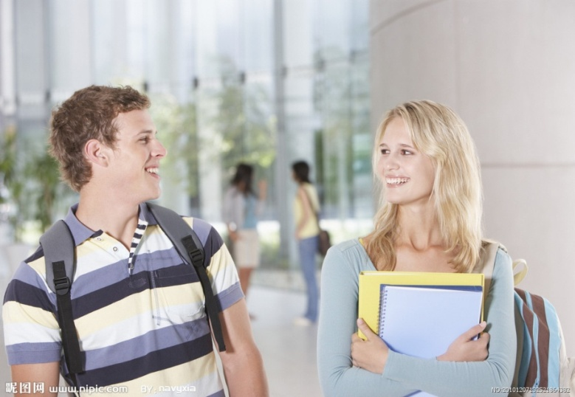
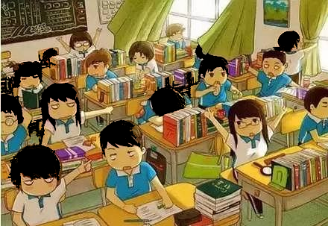
Pair Work
Let's talk about classmates.
---Who do you think is the most hard-working in the class?
---I think ...is the most hard-working student in our class.
---Who is the most creative/ the quietest/ the most serious...?
---.....

Slide 9
学习目标
Key words & phrases:
creative, performer, talent show, upside down, for sure.
Key sentences:
1. Who did you think was the best act?
2. My cousin Li Jing is the funniest person I know.
3. I don't know many people who can play the guitar upside down!
To learn to use the superlatives to describe people.

Slide 10


优翼英语教学课件（RJ）
八年级（上）

Slide 11


Unit 4 What’s the best movie theater ?
Section B (1a-1e)

Slide 12

写出下列形容词或副词的比较级和最高级。
funny
creative
quiet
good/well
boring
bad/badly
serious
funnier
funniest
adj.
有创造力的; 创造性的
more creative
most creative
quieter
quietest
better
best
more boring
most boring
worse
worst
more serious
most serious

Slide 13

Write these words and phrases next to their opposites(反义词) in the chart.
funniest most creative quietest best
most boring | most creative
loudest
worst
most serious
quietest
best
funniest

Slide 14

Discussion
Do you know what a talent show is in Chinese?
Did we have a talent show in the school?
If yes, when? Did you enjoy it?
If not, do you want to have a talent show in our school or class?

Slide 15
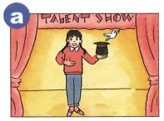
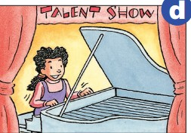
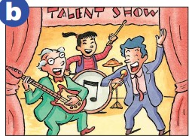
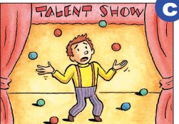
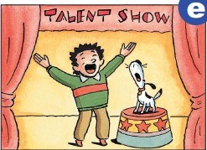
Today let’s go to another school’s talent show. What do they do?
do magic that a bird flys out the hat.
sing, play the guitar and and play the drums
play the piano
throw and catch the balls one by one
but keep dropping the balls
sing with his dog
一直掉球

Slide 16

While-listening
Listen to people talking about the school talent show. Match the pictures with the performers.
1c
n.表演者
d
a
Eliza ___ Vera ___ Steve ___ Dennis ____
The Math Teachers ___
e
c
b
Vera
Steve
The Math Teachers
Dennis
Eliza

Slide 17
Listen again. What do the people say about the performers? Fill in the chart with the adjectives(形容词) you hear.
1d
Names | What people say(describe them with adj)
Eliza | 1.best 2. 3.
Steve | 1.
Vera | 1. 2.
Dennis | 1. 2.
The Math Teachers | 1.
excellent
great
funniest
(most) creative
amazing
worst
terrible
loudest

Slide 18
Let’s read.
Girl 1: Wasn’t that a great talent show?
Girl 2: Yeah!
Girl 1: Who did you think was the best act?
Girl 2: Oh, I thought Eliza was the best. She’s an excellent piano player.
Girl 1: Yeah, she’s great. And I thought Steve and his dog were the funniest.
Girl 2: Me, too! I couldn’t stop laughing! And how about Vera? Wasn’t she creative?

Slide 19
Girl 1: Yeah, I’d say she was the most creative act! It was amazing when the bird flew out of the hat!
Girl 2: Who did you think was the worst?
Girl 1: Oh, Dennis! He was terrible! He kept dropping the balls!
Girl 2: I know!
Girl 1: What did you think of The Math Teachers?
Girl 2: Well, they were the loudest for sure!

Slide 20
Describe the person using the information in 1d:
1. Eliza was the best. She was an excellent and great piano player.
2. Steve and his dog were the funniest. They made everyone laugh.
3. Vera was the most creative.
...

Slide 21
Post-listening
1e
Look at the information in 1d and make a conversation.
A:Who was the best performer?
B: Eliza was the best performer.

Slide 22
Pair Work
Let's practice!
Ask and answer quickly.
A: Who was the best performer?
B: Eliza was the best performer.
A: Who was the funniest performer?
B: Steve was the funniest performer.
A: Who was the most creative performer?
B: Vera was the most creative performer.
A: Who was the worst performer?
B: Dennis was the worst performer.
A: Who was the loudest performer?
B: The Math Teachers were the loudest performers.

Slide 23
Language points
1. Wasn't she creative?
【词汇拓展】
create v. 创造
creative adj. 有创造力的
creativity n. 创造力
creation n.创造；作品 a literary creation 文学作品
creator n. 创作者；创造者

Slide 24
e.g. The factory created more jobs for local farmers.
Jim is the most creative student in the class.
Creativity is the most important.
Walt Disney is the creator of Mickey Mouse.

Slide 25
2. Who was the best performer?
performer n. 表演者
【词汇拓展】
perform v. 表演；表现；执行
performance n. 表演；表现
e.g. A computer can perform many tasks at the same time.
It was a fantastic performance.

Slide 26
I. 单项选择
Exercises
1. This book is ____ of all.
A. cheapest B. cheap C. cheaper D. the cheapest
2. He is much ____ than his brother.
A. taller B. tall C. the tallest D. tallest
3. Li Lei is ____ older than Lucy.
A. quite B. very C. much D. more
D
A
C

Slide 27
4.In order to sell more products, we need to come up with more ______ ideas.
A. true B. common C. simple D. creative
5. This is one of ____ films of this year.
A. more exciting B. exciting
C. the most exciting D. most exciting
6. The weather in Beijing is colder than _____.
A. in Guangzhou B. Guangzhou
C. that in Guangzhou D. that from Guangzhou
D
C
C

Slide 28
Ⅱ. 用所给单词的适当形式填空
1.Nothing is a waste if you have a ________ (create) mind.
2.He did ________ (badly) among the students in his class.
3.Lucy’s sister is a talented _________ (perform). We are watching her dance in the theatre.
4.I turned back after a while, but he kept ________ (walk).
5.Mr. William is the __________ (boring) person I know.
creative
worst
performer
walking
most boring

Slide 29

Homework
Preview the passage in Section B 2b.
Do the exercises in students’ book.

Slide 30



Slide 31
声 明
本文件著作权为创作公司所有, 仅限于教师教学及其他非商业性和非盈利性用途。如发现盗用、转卖、网络传播等侵权行为, 本公司将依法追究其相应法律责任。
部分素材选自网络, 如有争议, 请联系删改。

